Slide 1
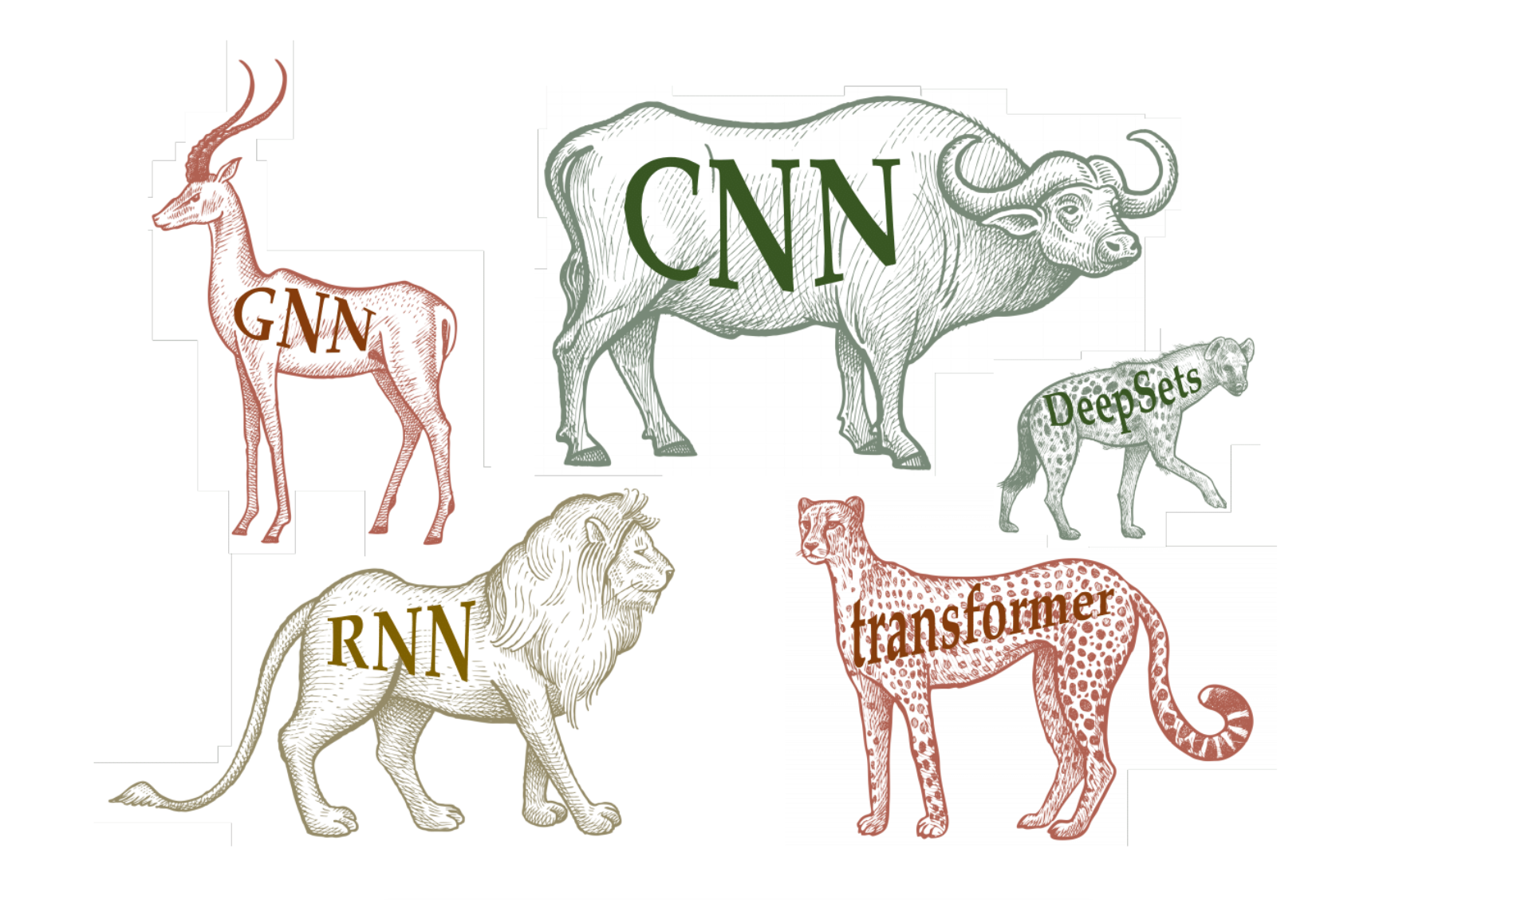
CS 7180: Topics in AI
Geometric Deep Learning
Image credit: Michael Bronstein

Slide 2
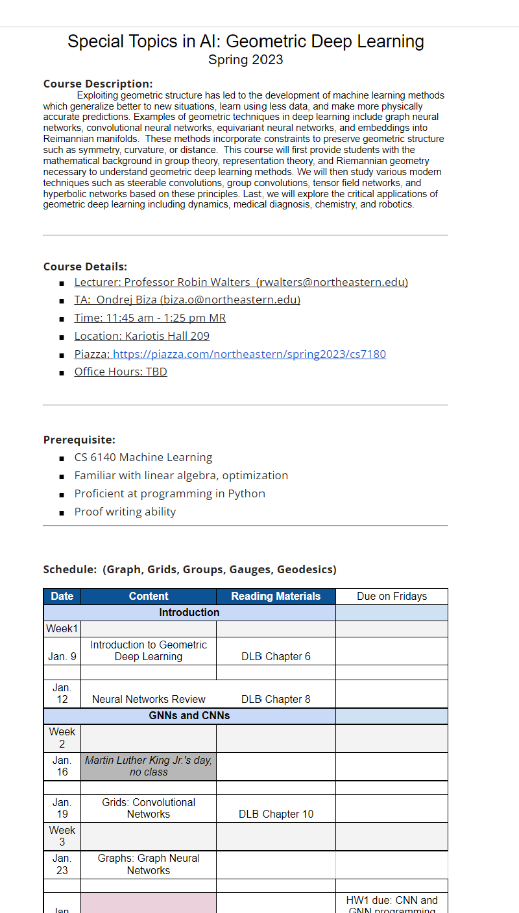
Course Website
Linked from Piazza
Schedule
Grading Breakdown
Office Hours / Locations
References on DL / GDL / Group Theory

Slide 3
Grading Breakdown
50% - Course Project
Develop research project in the mold of the papers we read in class to apply geometric deep learning to an application or to better understand fundamental methods
Work in teams of 1-3
9 page paper and final presentation
Project Milestones
25% - Homework
Programming assignments and math problem sets
25% - Class Participation
Everyone presents a paper – 20 minutes polished presentation in class
In-class and online discussion of papers is required from all students every week

Slide 4
What is Geometric Deep Learning?
Image credit: Michael Bronstein

Slide 5
Goal: Exploit the Geometric Structure of Data in the design of the neural network
What kinds of structured data can you think of?

Slide 6
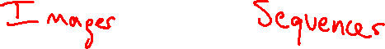

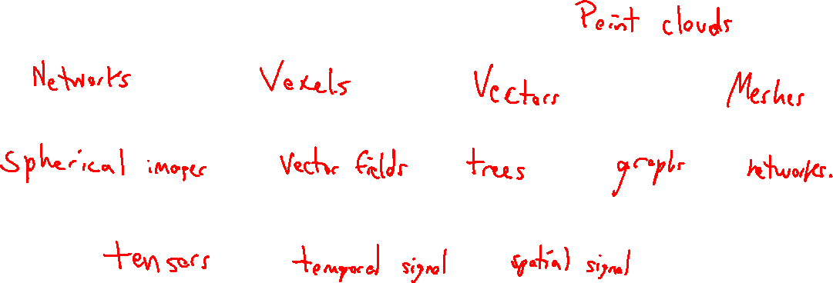
Goal: Exploit the Geometric Structure of Data in the design of the neural network
What kinds of structured data can you think of?

Slide 7
Goal: Exploit the Geometric Structure of Data in the design of the neural network
Philosophy: Structure of data should inform structure of the neural network.

Slide 8
Goal: Exploit the Geometric Structure of Data in the design of the neural network
Philosophy: Structure of data should inform structure of the neural network.
The geometric structure of the data is an inductive bias or geometric prior.
Something we know a priori and thus can exploit without learning it from data.

Slide 9
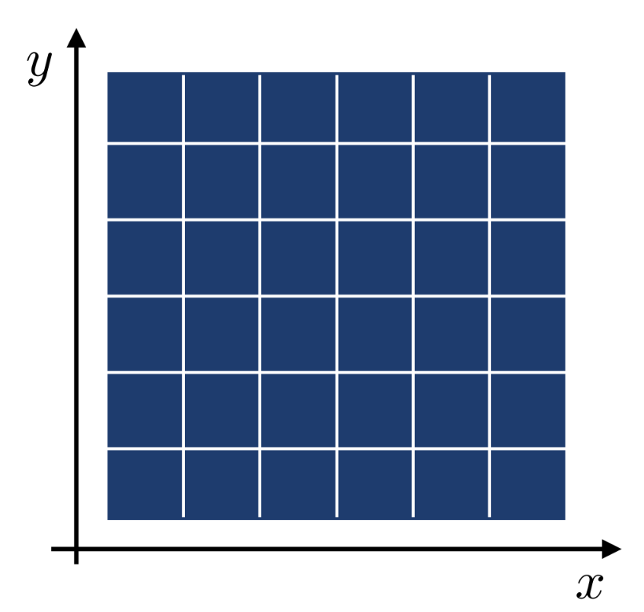
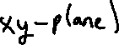

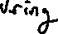
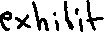

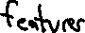

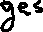

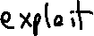
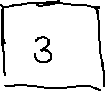
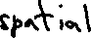
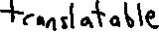
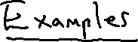
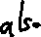
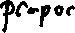

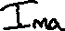
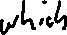
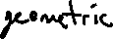
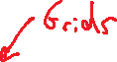
Goal: Exploit the Geometric Structure of Data in the design of the neural network

Slide 10
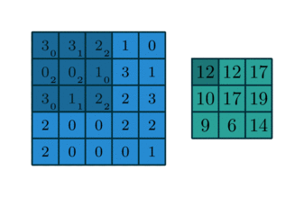
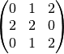
Convolution
filter weights:
take inner (dot) product of filter and each input location
measures degree of filter feature at input location
feature map
http://deeplearning.net/software/theano_versions/dev/tutorial/conv_arithmetic.html

Slide 11
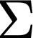
locality and translation invariance into inductive biases
inputs can be
restricted to regions
locality
nearby areas tend to contain stronger patterns
maintain spatial ordering
same filters can be applied
throughout the input
translation
invariance
relative positions are relevant
same weights
Image credit: Rose Yu

Slide 12
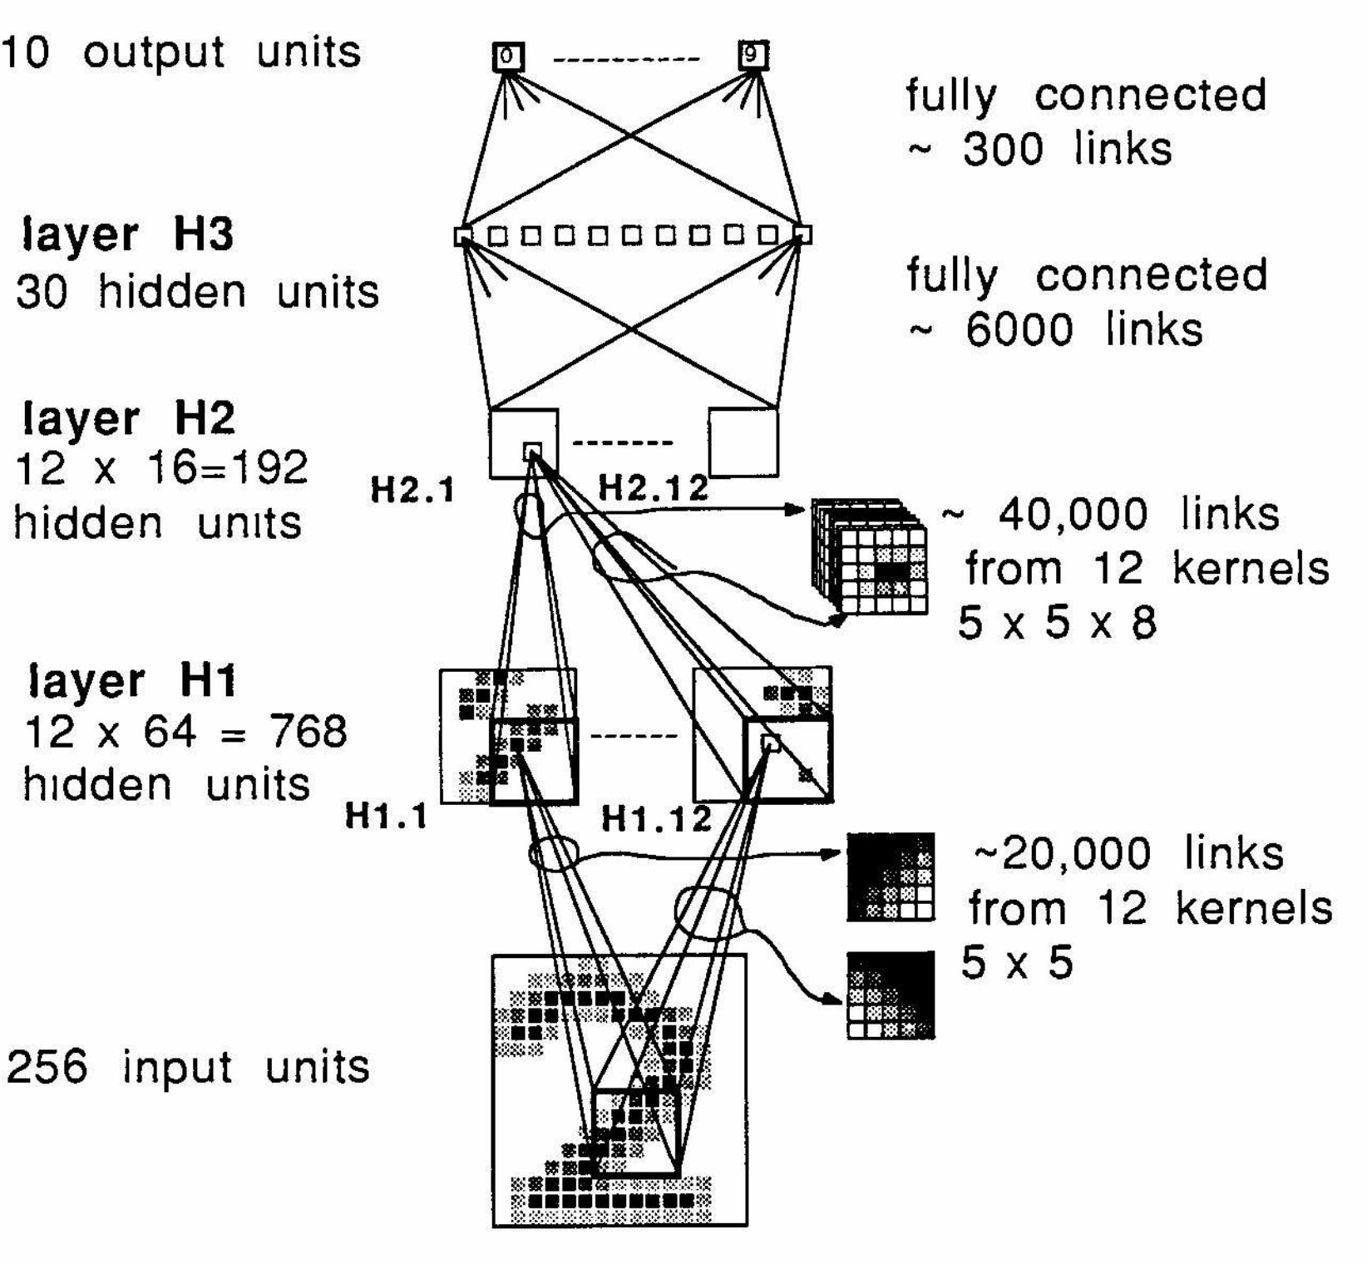

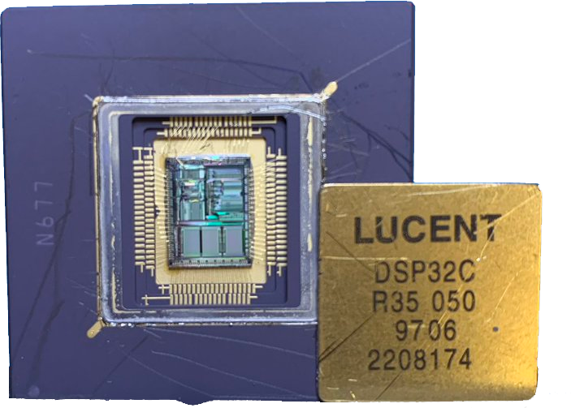
Convolutional neural networks
AT&T DSP-32C
capable of 125m floating point multiply-accumulate operations/sec
Y. LeCun
First version of a CNN
LeCun et al. 1989
Image credit: Michael Bronstein

Slide 13
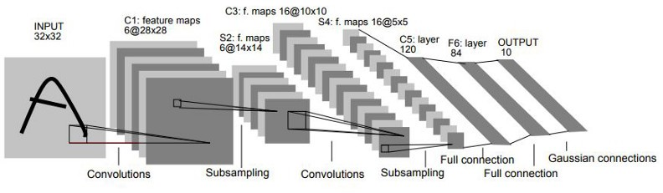
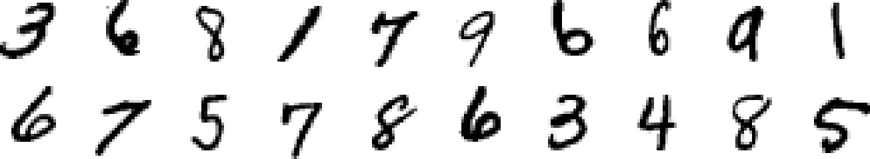
LeNet-5
LeNet-5 classical CNN architecture
Y. LeCun
MNIST digits dataset
LeCun et al. 1998
Image credit: Michael Bronstein

Slide 14

⋮
+
⋮
input image
input vector
Image credit: Michael Bronstein

Slide 15
⋮
+
⋮
input image input vector
“The response of [Perceptrons] was severely affected by the shift in position […] of the input patterns. Hence, their ability for pattern recognition was not so high.”— Fukushima
Image credit: Michael Bronstein

Slide 16
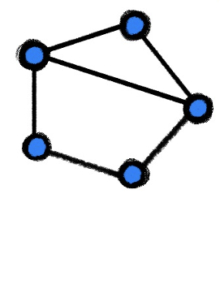
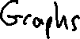
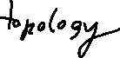
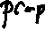
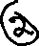
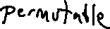
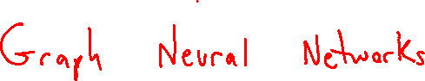
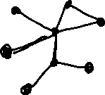
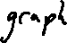
Goal: Exploit the Geometric Structure of Data in the design of the neural network

Slide 17
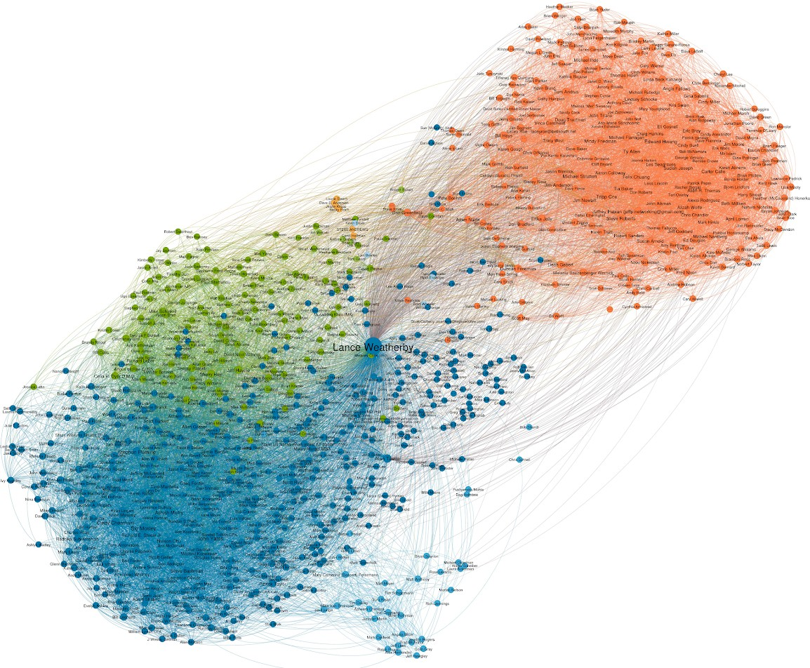
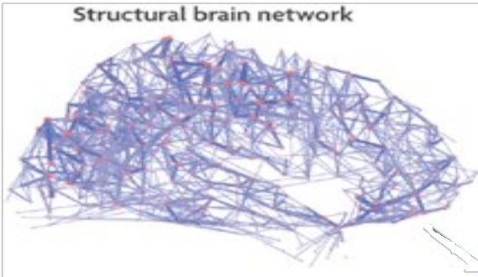
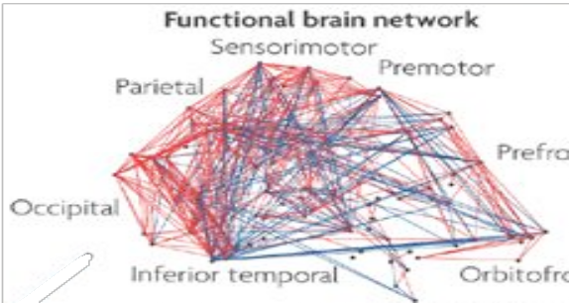


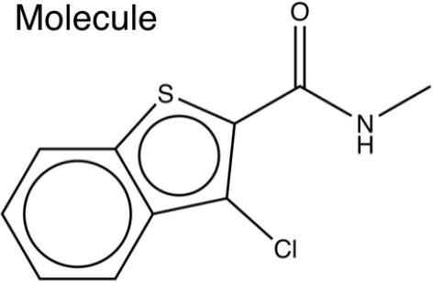
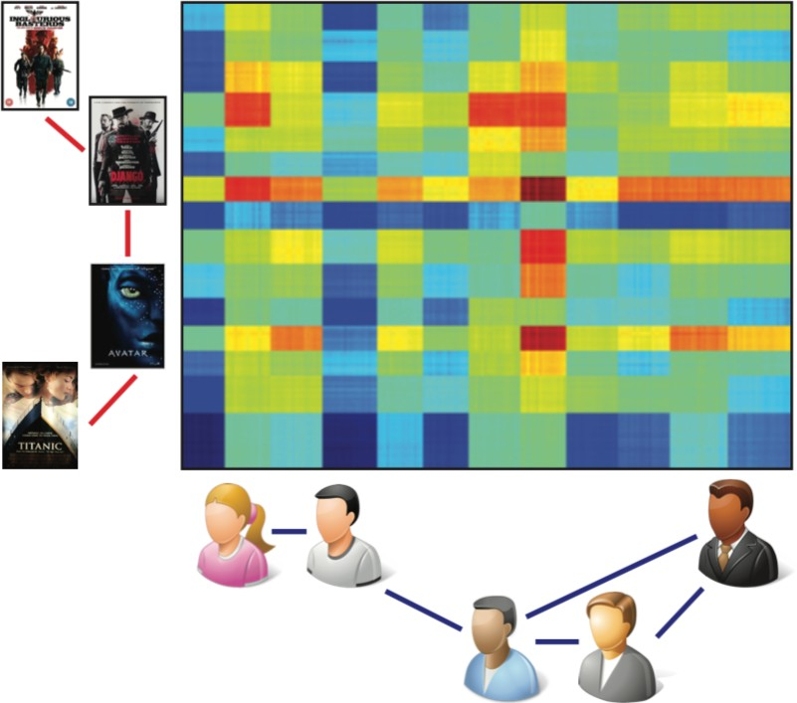
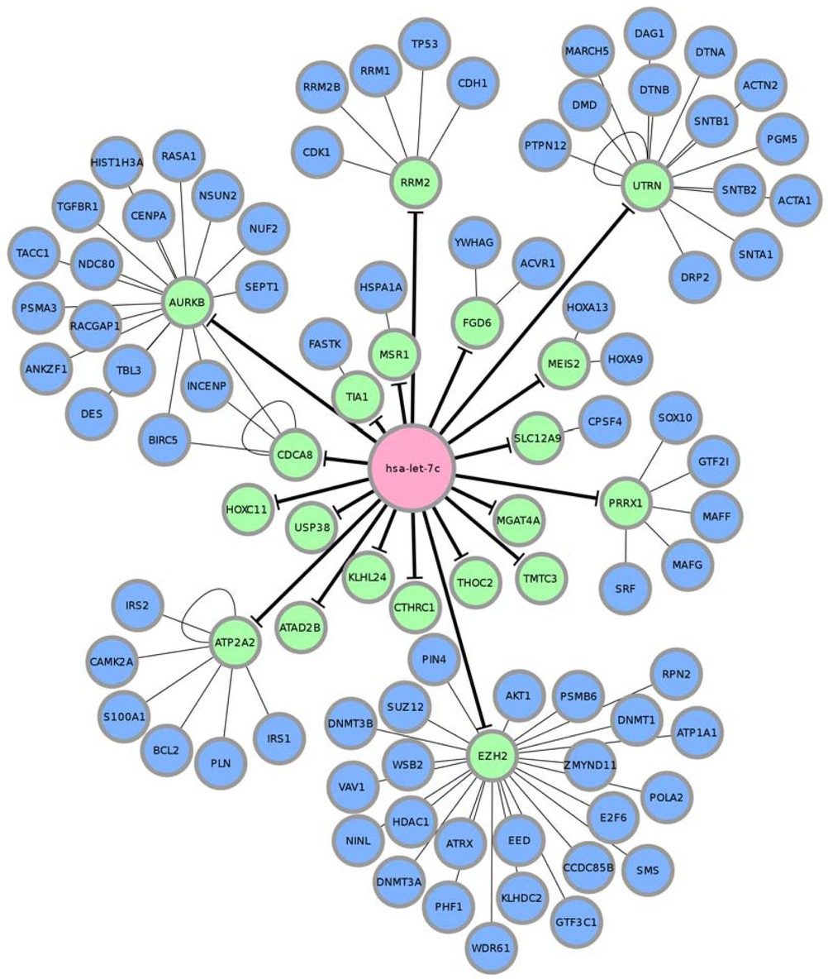
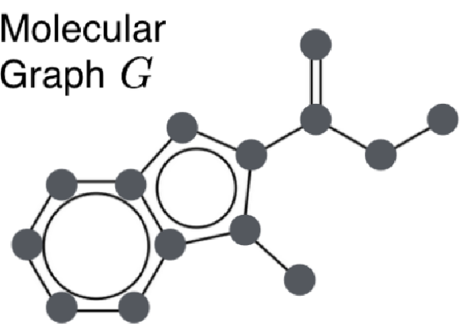
Graph-structured data
https://towardsdatascience.com/geometric-foundations-of-deep-learning-94cdd45b451d

Slide 18
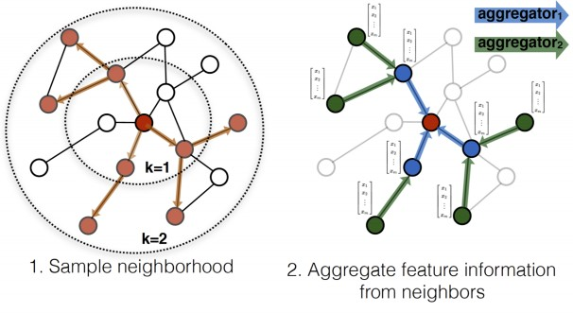
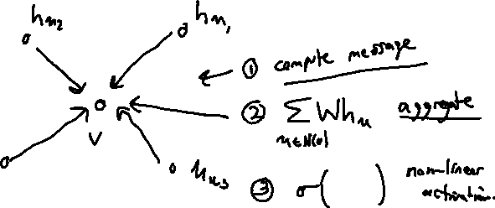
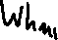

Graph Neural Networks use Message-Passing
∑ Wh_{u})
u∈N(v)
h_{v} =σ(

Slide 19
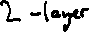
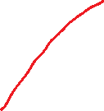
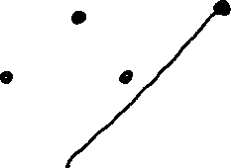













Neural Network Structure Mirrors Graph Structure

Slide 20




Flavors of GNNs
Image credit: Michael M. Bronstein, Joan Bruna, Taco Cohen, Petar Veličković

Slide 21













Goal: Exploit the Geometric Structure of Data in the design of the neural network

Slide 22


task: speech recognition from audio data
Graves & Jaitly, 2014
mapping from input waveform to sequence of characters
Image credit: Rose Yu

Slide 23


let’s translate locality and translation invariance into inductive biases
inputs can be restricted to regions
t
locality
nearby areas tend to contain stronger patterns
⌃
maintain temporal ordering
same weights can be applied throughout the input
translation invariance
relative positions are relevant
t
⌃
⌃

Slide 24
mirror the sequential structure of the data,
we can process the data sequentially
Output
Hidden
Input
t
each set of colored arrows denotes shared weights
maintain an internal representation during processing potentially infinite effective input window fixed number of parameters

Slide 25

















Goal: Exploit the Geometric Structure of Data in the design of the neural network

Slide 26





Task: Point Cloud Object Classification

Slide 27






















Invariances
Permutation Invariance
Frame Invariance

Slide 28



Lagrangian Fluid Simulation with Continuous Convolution

Slide 29

Lagrangian Fluid Simulation with Continuous Convolution

Slide 30

SE(3)-Transformer

Slide 31














Goal: Exploit the Geometric Structure of Data in the design of the neural network

Slide 32
Gauge-Invariance
Geometric quantities on manifolds are written with respect to local coordinates
There is no consistent choice of local coordinates across the manifold.
The result of any computation should be independent of choice of local coordinates

Slide 33




Example: Wind Vector Field on Earth

Slide 34






Gauge Equivariant Convolutional Networks and Icosohedral CNN – Cohen et al

Slide 35



Gauge Equivariant Mesh CNNS – Anisotropic Convolutions on Geometric Graphs – de Haan et al

